Slide 1
Data Science and Big Data Analytics Lab
Mini Project
31249 Divya Lambhate
31251 Aditya Magdum

Slide 2
Problem Statement
Use the following covid_vaccine_statewise.csv dataset and perform the following analytics on the given dataset: COVID-19 in India | Kaggle
Describe the dataset.
Number of person vaccinated statewise for first dose in India.
Number of person vaccinated statewise for second dose in India.
Number of males vaccinated.
Number of females vaccinated.

Slide 3
About the Dataset
The dataset contains various records about first and second dose of covid vaccine as well as the type of vaccine in different states of India during a certain time interval.
The dataset consists of 7845 rows and 24 columns.
It has individual day wise record as well as the cumulative records till that date about males vaccinated, females vaccinated, covishield vaccine, covaxin vaccine, sputnik vaccine, age group wise and overall vaccine count for the day.

Slide 4
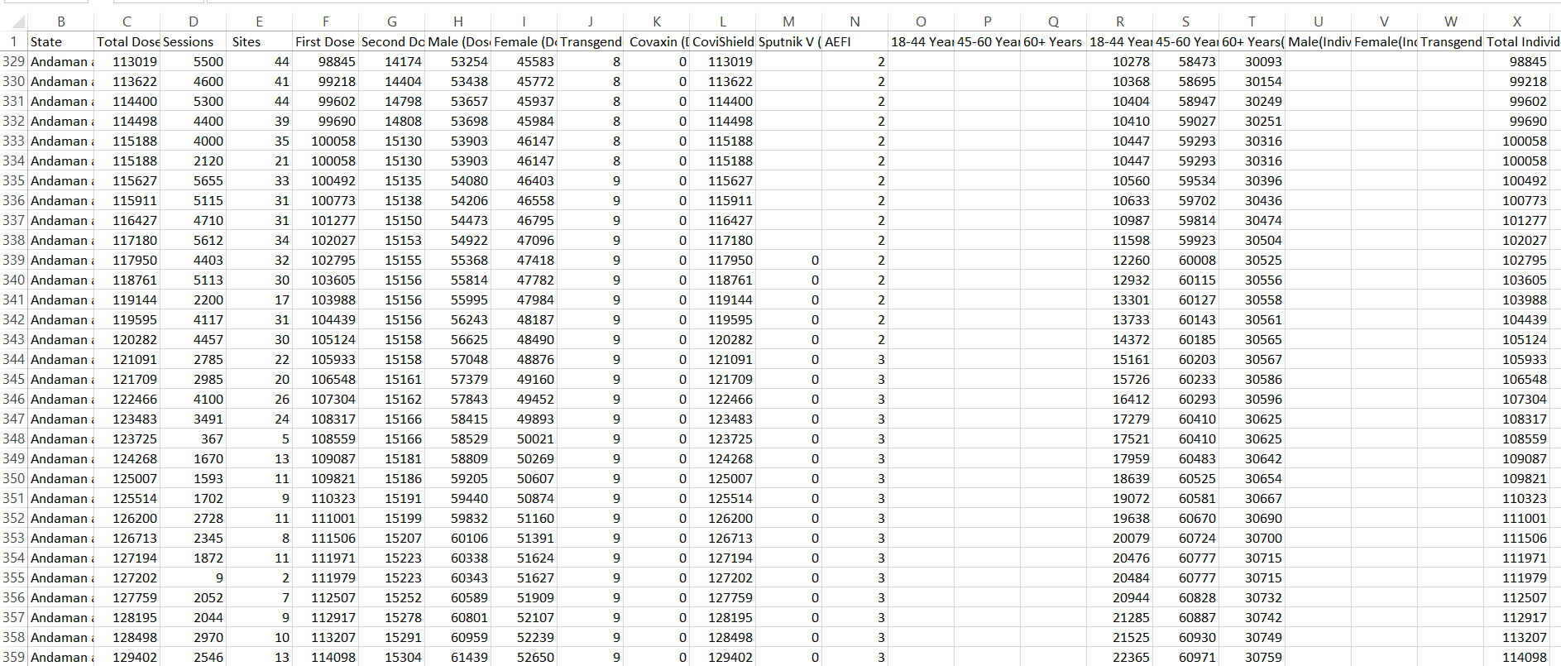
Glimpse of the Dataset

Slide 5
Libraries Used
Pandas: Pandas is a Python library used for working with data set. It has functions for analyzing, cleaning, exploring, and manipulating data. Pandas allows us to analyze big data and make conclusions based on statistical theories. Pandas can clean messy data sets, and make them readable and relevant. Relevant data is very important in data science.
Numpy: NumPy is a Python library that provides a simple yet powerful data structure: the n-dimensional array. This is the foundation on which almost all the power of Python’s data science toolkit is built.

Slide 6
Methods Used
describe() : Used for calculating some statistical data like percentile, mean, min, max, std deviation of numerical values of the dataframe.
shape(): It gives the size of the dataframe.
info(): It gives the count of non null values for each column and datatype of each column
fillna(): This method is used to fill the NAN values with other value.
groupby(): It is used to aggregate the rows on certain values in the columns.
sum(): It adds the values of the elements in a selected dataframe.

Slide 7
Thank You

